Slide 1

MALIGNANT COMMENTS CLASSIFICATION PROJECT
Submitted by
NARRALA HOMAKIRAN

Slide 2
INTRODUCTION
The proliferation of social media enables people to express their opinions widely online. However, at the same time, this has resulted in the emergence of conflict and hate, making online environments uninviting for users. Although researchers have found that hate is a problem across multiple platforms, there is a lack of models for online hate detection.
Online hate, described as abusive language, aggression, cyberbullying, hatefulness and many others has been identified as a major threat on online social media platforms. Social media platforms are the most prominent grounds for such toxic behaviour.
There has been a remarkable increase in the cases of cyberbullying and trolls on various social media platforms. Many celebrities and influences are facing backlashes from people and have to come across hateful and offensive comments. This can take a toll on anyone and affect them mentally leading to depression, mental illness, self-hatred and suicidal thoughts.
Internet comments are bastions of hatred and vitriol. While online anonymity has provided a new outlet for aggression and hate speech, machine learning can be used to fight it. The problem we sought to solve was the tagging of internet comments that are aggressive towards other users. This means that insults to third parties such as celebrities will be tagged as unoffensive, but “u are an idiot” is clearly offensive.

Slide 3
PROBLEM STATEMENT
Our goal is to build a prototype of online hate and abuse comment classifier which can used to classify hate and offensive comments so that it can be controlled and restricted from spreading hatred and cyber bullying.

Slide 4
ANALYTICAL PROBLEM FRAMING
With continuous increase in available data, there is a pressing need to organize it and modern classification problems often involve the prediction of multiple labels simultaneously associated with a single instance. Known as Multi-Label Classification, it is one such task which is omnipresent in many real world problems. In this project also, we have multi-label classification problem.
We have used Tf-Idf Vectorizer to vectorize the words in our dataset. TF-IDF is an abbreviation for Term Frequency Inverse Document Frequency.
This is very common algorithm to transform text into a meaningful representation of numbers which is used to fit machine algorithm for prediction. It is very important for tuning performance on NLP projects.

Slide 5
DATA SOURCES
The data set contains the training set, which has approximately 1,59,000 samples and the test set which contains nearly 1,53,000 samples. All the data samples contain 8 fields which includes ‘Id’, ‘Comments’, ‘Malignant’, ‘Highly malignant’, ‘Rude’, ‘Threat’, ‘Abuse’ and ‘Loathe’.
The label can be either 0 or 1, where 0 denotes a NO while 1 denotes a YES. There are various comments which have multiple labels. The first attribute is a unique ID associated with each comment.
The data set includes:
Malignant: It is the Label column, which includes values 0 and 1, denoting if the comment is malignant or not.
Highly Malignant: It denotes comments that are highly malignant and hurtful.
Rude: It denotes comments that are very rude and offensive.
Threat: It contains indication of the comments that are giving any threat to someone.
Abuse: It is for comments that are abusive in nature.
Loathe: It describes the comments which are hateful and loathing in nature.
ID: It includes unique Ids associated with each comment text given.
Comment text: This column contains the comments extracted from various social media platforms.

Slide 6
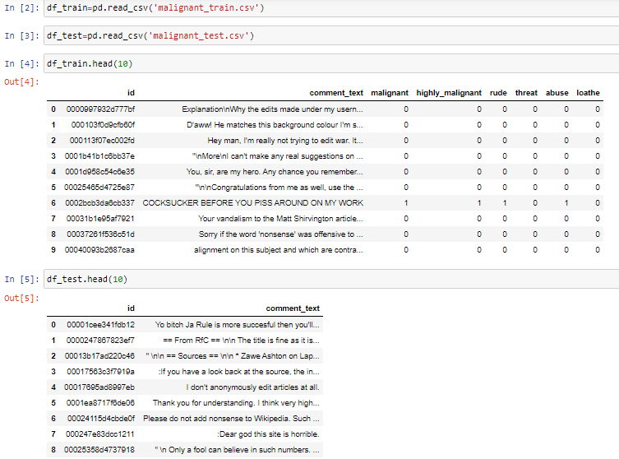
The sample data for the reference is as shown below:

Slide 7
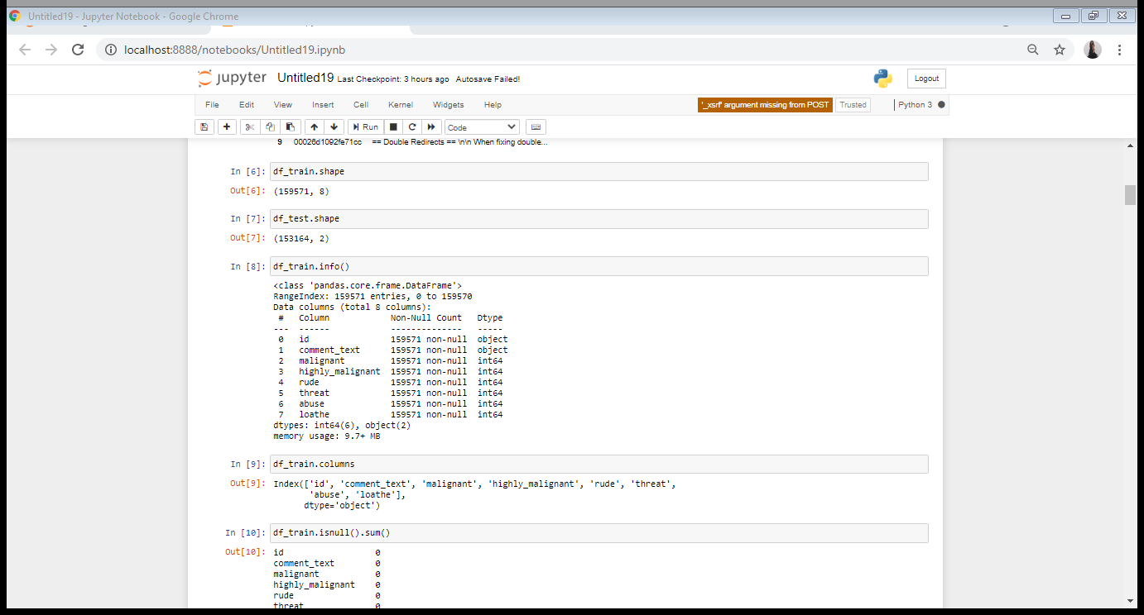
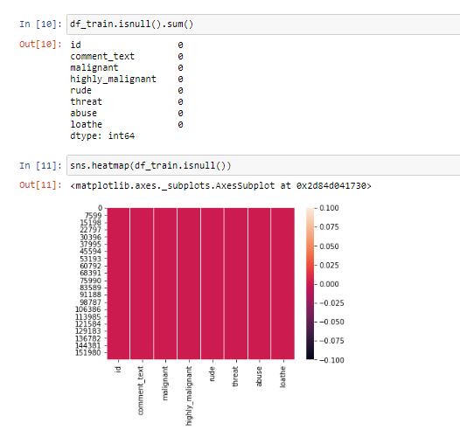
Then we further checked more about data using info, shapes using .shape, columns using .columns(),null values using .isnull. .sum().sum(), and further visualize it through heatmap as follows:

Slide 8
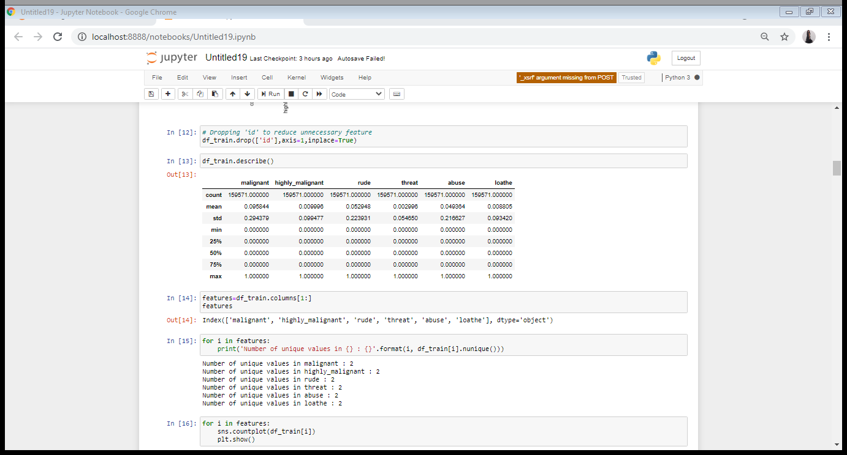
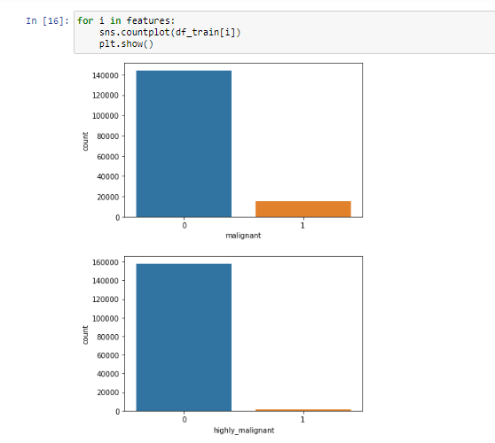
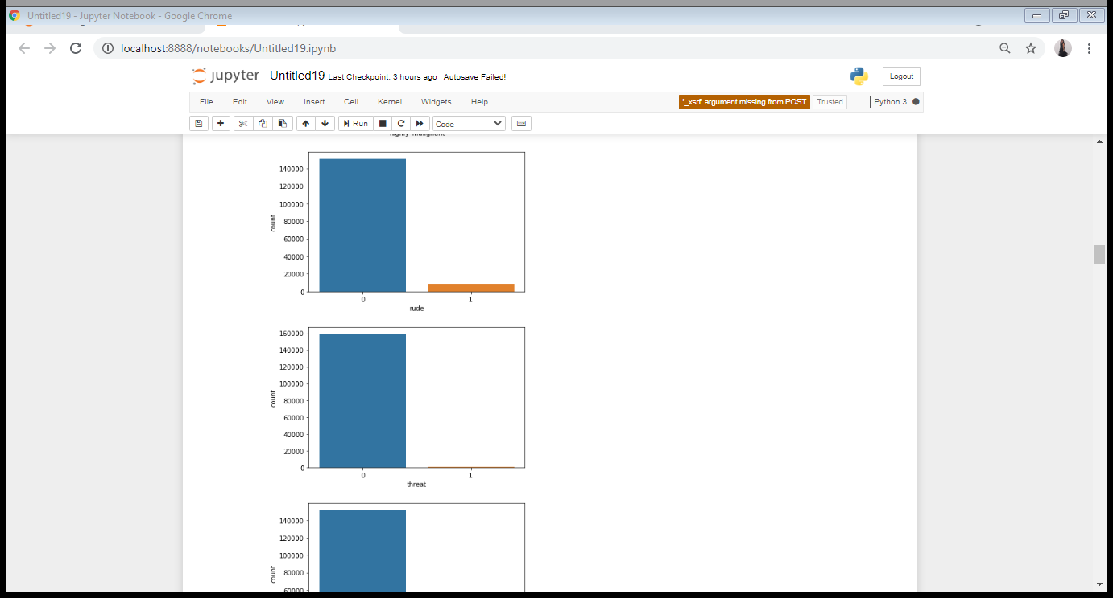
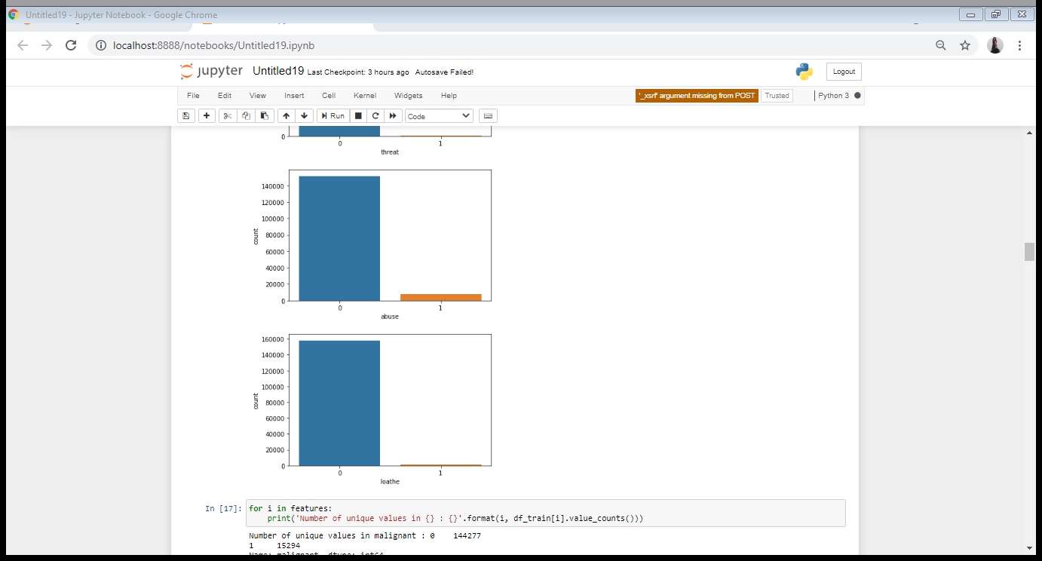
EXPLORATORY DATA ANALYSIS(EDA)

Slide 9
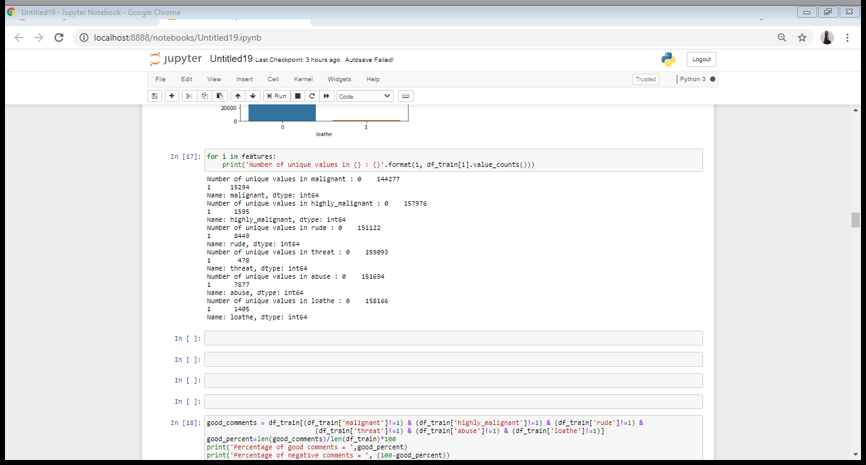
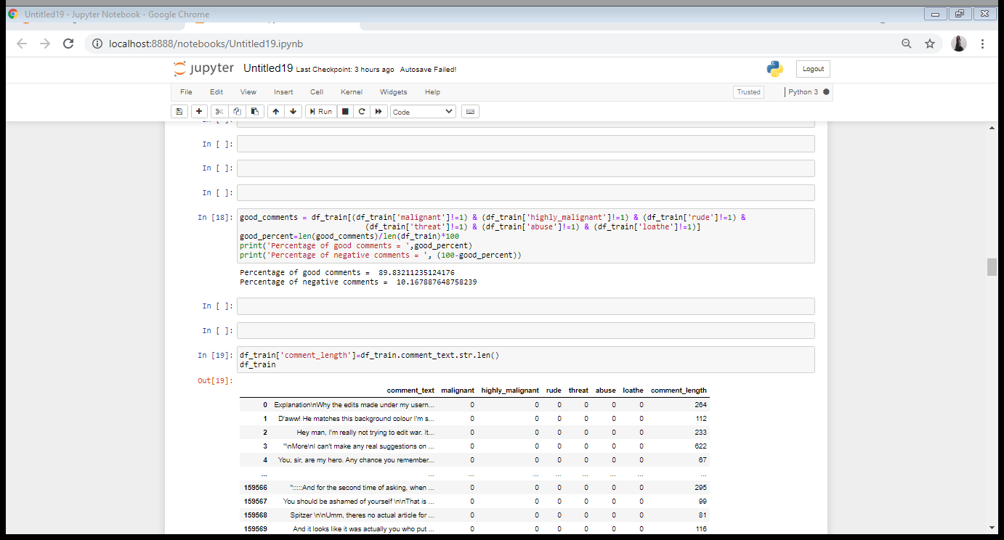
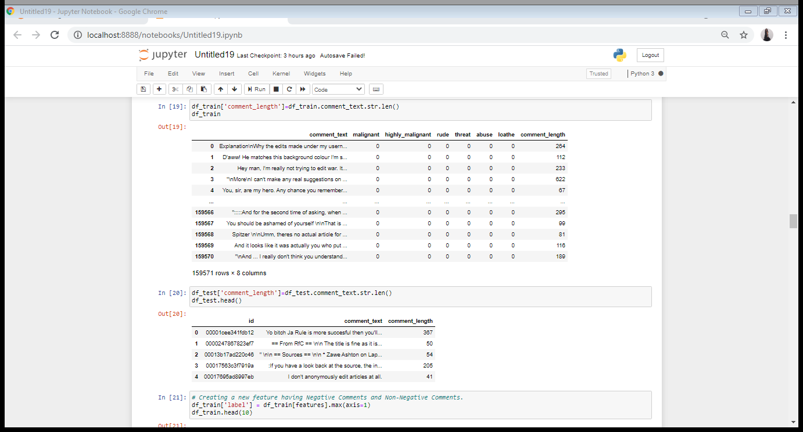

Slide 10
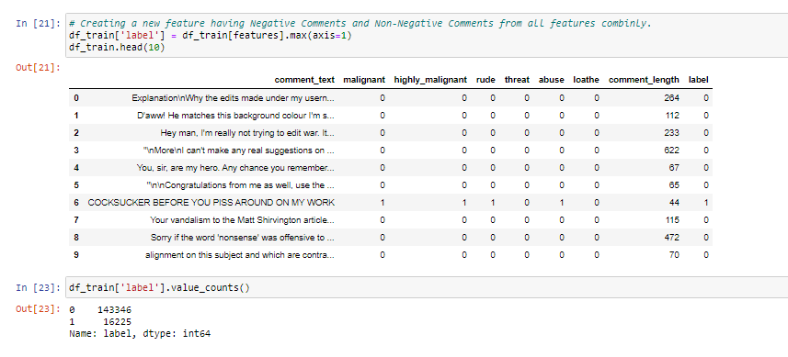
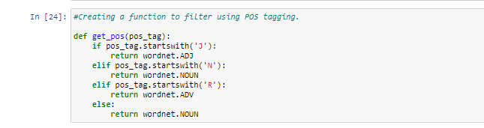
Adding a new column ‘label’ to get value counts.
Data Pre-Processing:
We have used a function to filter using POS tagging. Also, all the pre-processing steps needed to clean the data.

Slide 11
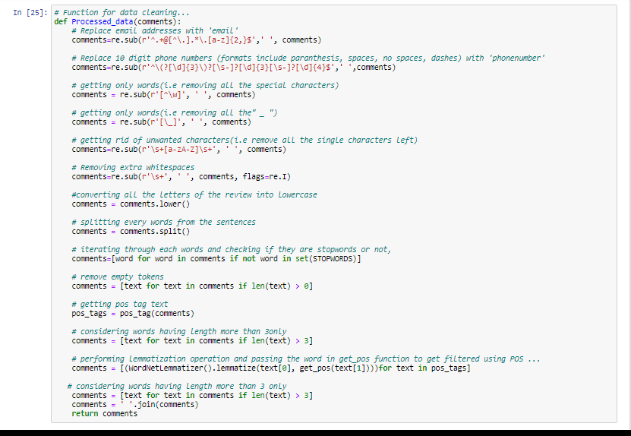
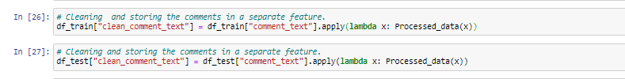
After performing all the above steps and also adding a new feature to check new comment length after cleaning, our dataset would look as follows:

Slide 12
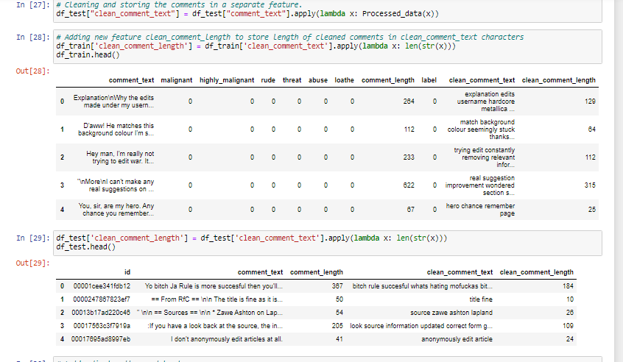
Dataset after Pre-Processing:

Slide 13
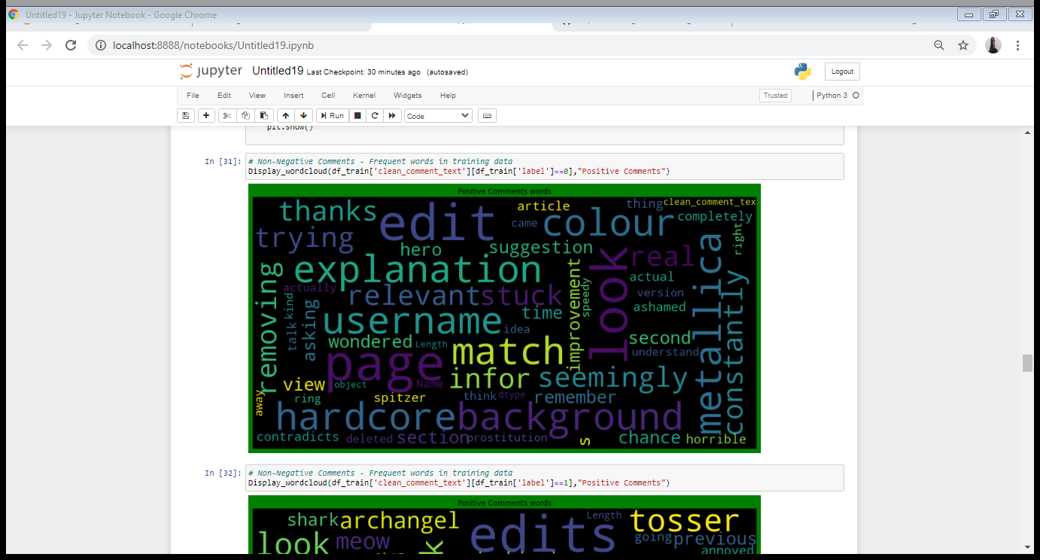
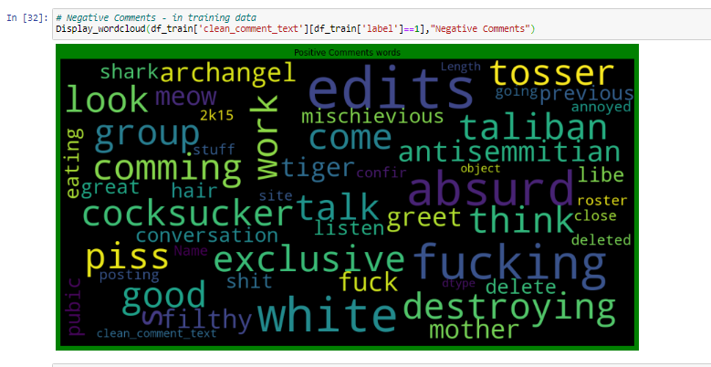
We have also observed most frequent words in positive and negative comments through word-cloud:

Slide 14
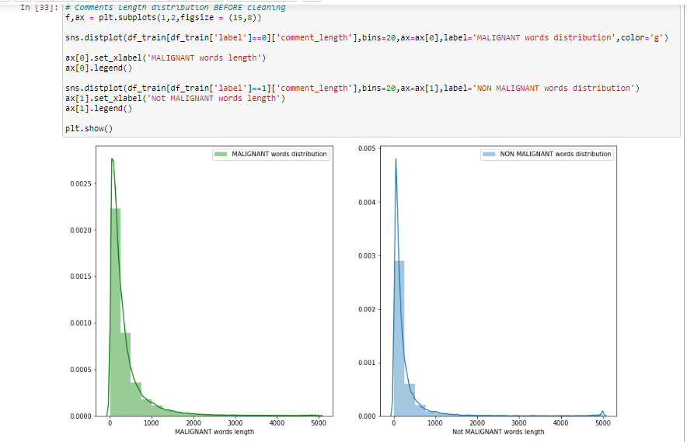
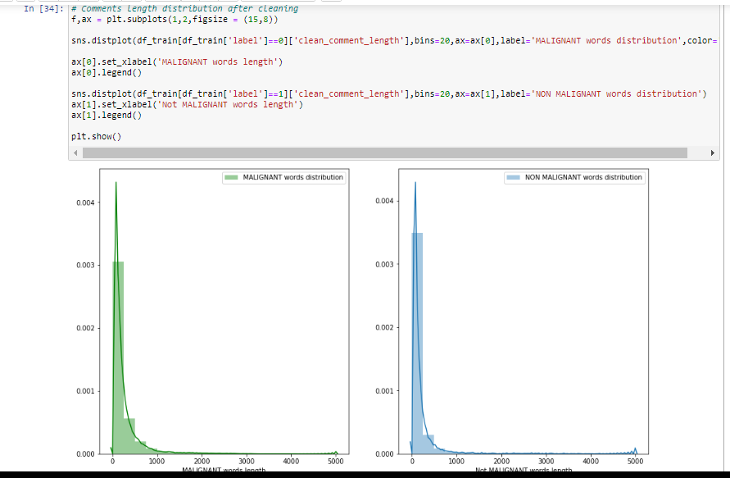
We have checked distribution of comment length before and after cleaning.
Before cleaning
After cleaning

Slide 15
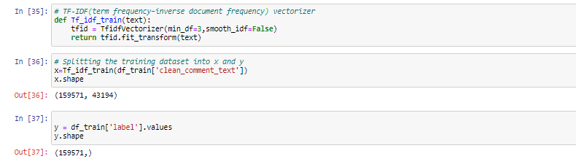
PREPARING DATA FOR MODELLING
We are using TF-IDF vectorizer for vectorizing the words.

Slide 16
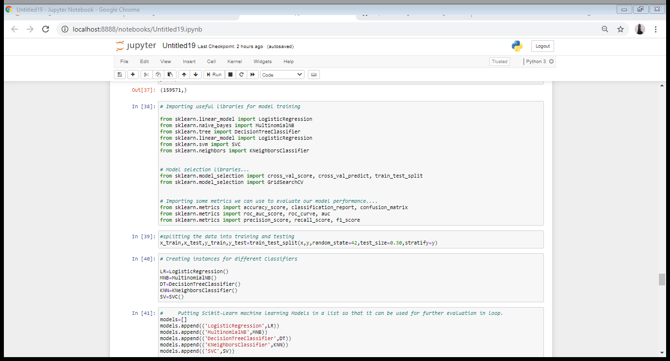
MODEL BUILDING

Slide 17
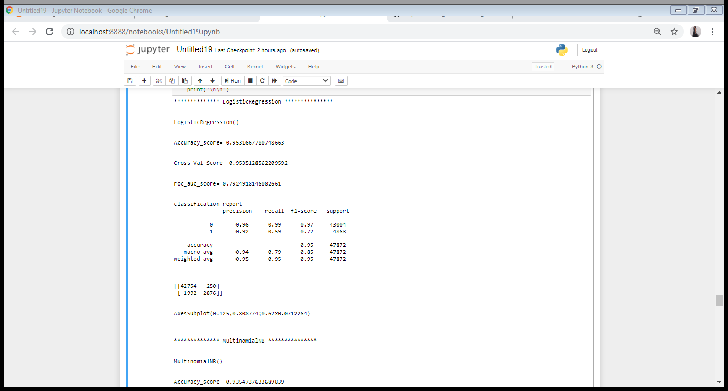
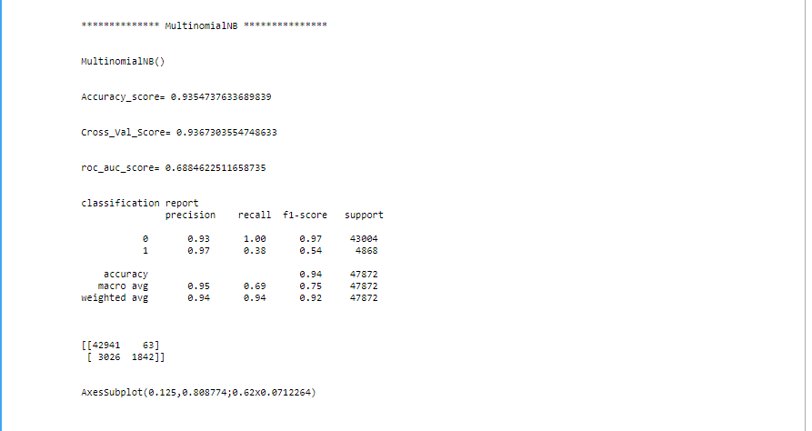
Following results are obtained after training the model on various algorithms:

Slide 18
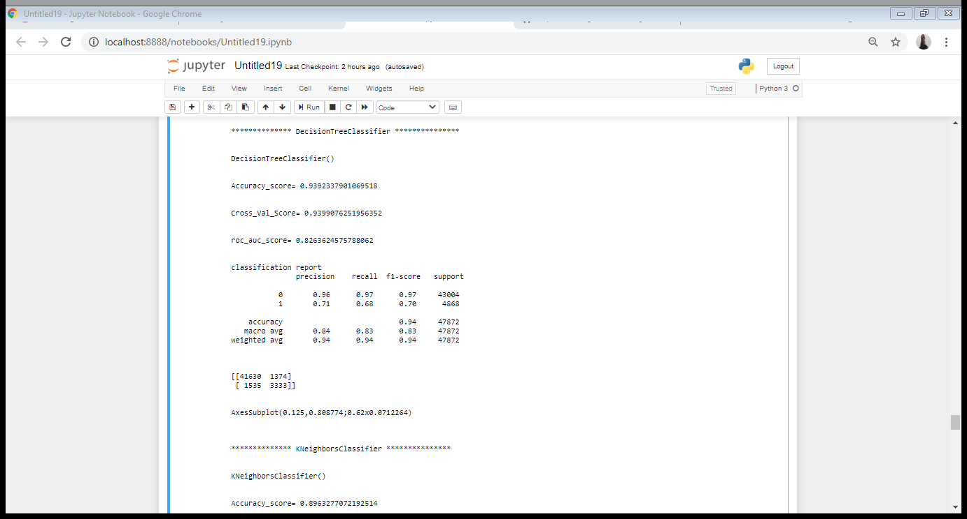
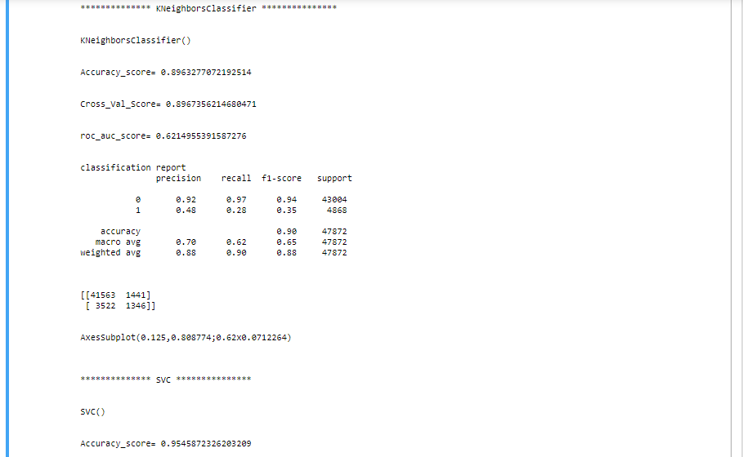

Slide 19
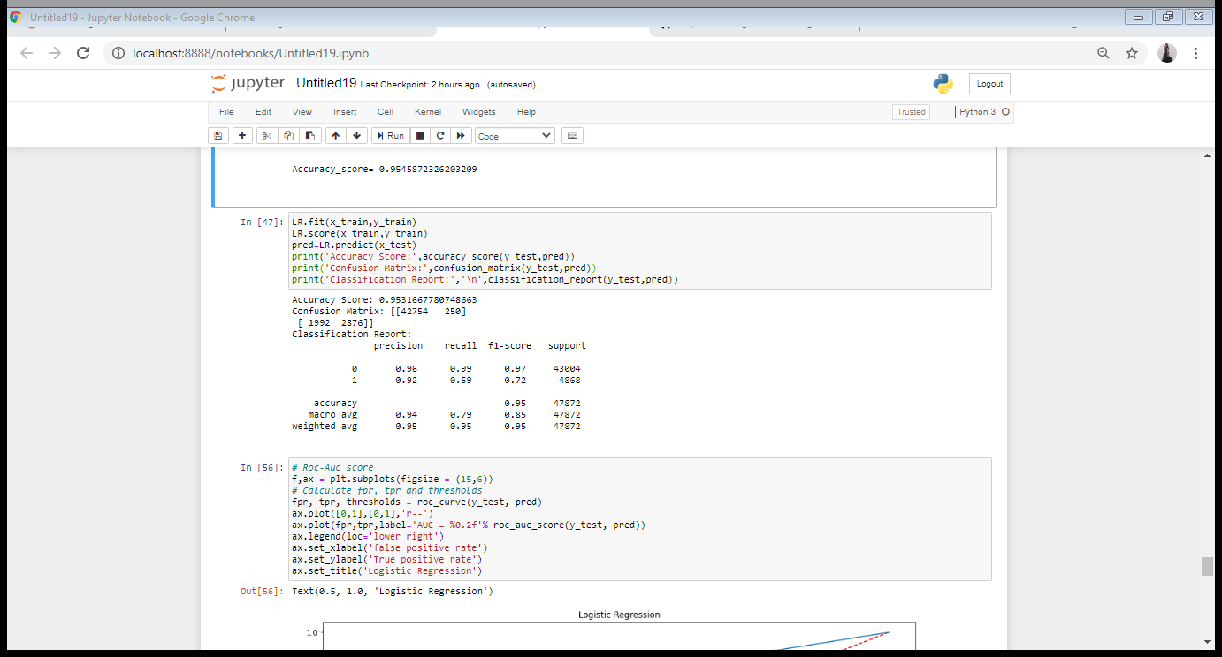
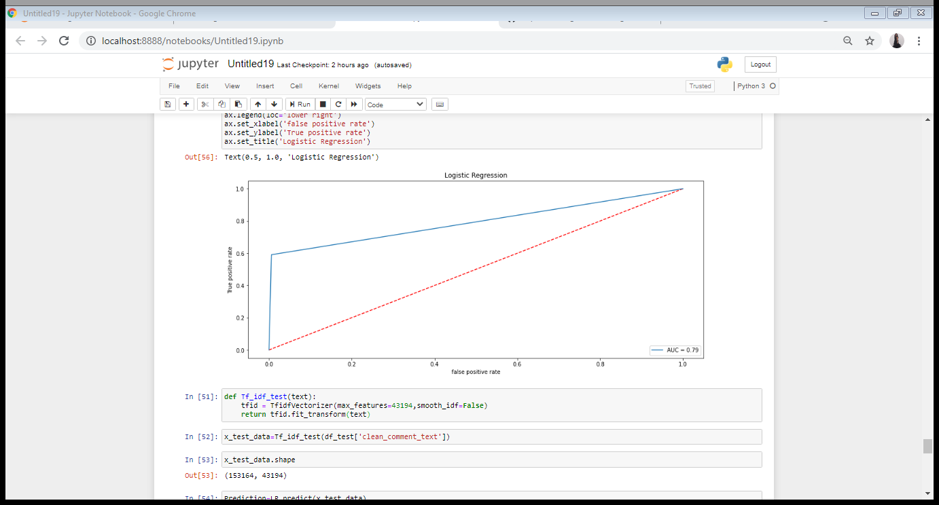
Out of all the algorithms, Logistic Regression was giving best score. Also, its cross validation score was also satisfactory. Its ROC_AUC curve is as shown:

Slide 20
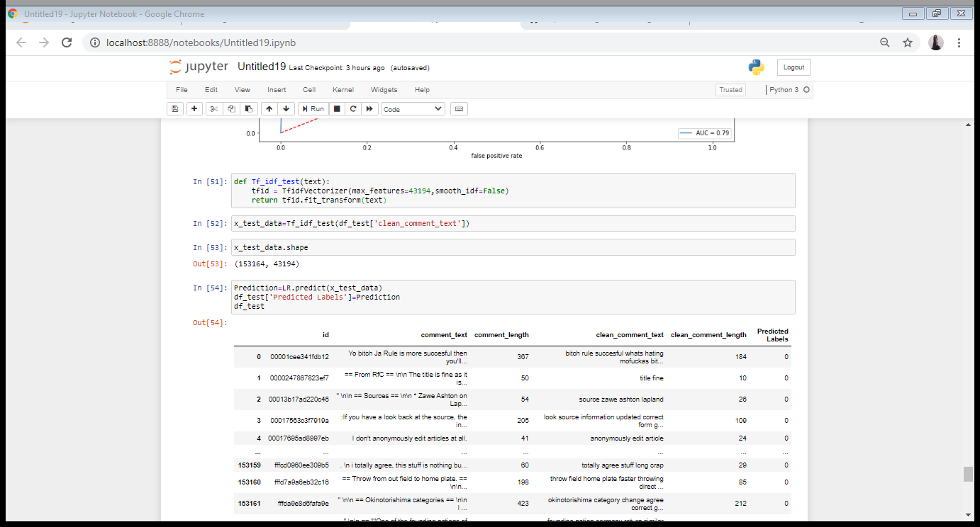
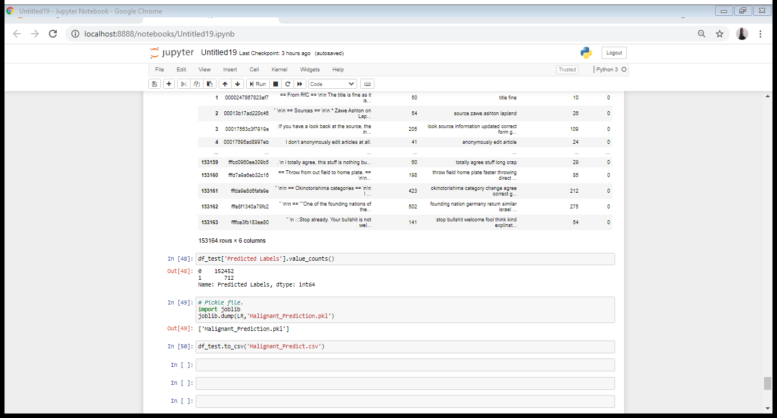
PREDICTING TEST DATASET
Most of the predicted labels were Non-Negative Comments.
Only few were Negative.

Slide 21
CONCLUSION
We had got a Logistic Regression as the best model since it’s giving us good result and other metrics are also satisfactory with AUC , ROC curve too.
Using Logistic Regression as our final algorithm we have predicted the values for test dataset and it’s also working well and is able to differentiate/predict negative comments and non-negative (good) comments.

